Slide 1
EagleSat Solar Power Optimization
By: Darin Baker

Slide 2
Contents
Introduction
Electric Power System
Optimization
Design
Testing
Risks
Personal Improvement

Slide 3
Introduction
Background
EagleSat is a 1U CubeSat
Delivery Date: Fall of 2015
First solar array version completed last year
Purpose
The final products
Solar power engineering model 4/15/14
Test Results
Power produced in a simulated space environment
Balloon Flight Data
Education and Experience
Notes:
Time spent here will depend on how much of audience has sat through all previous EagleSat presentations
1U-10X10X10 cm (will be restated on slide 5)
Delivered to NASA – Launch from ISS
Continuation of previous design
PURPOSE- 2 main purposes Complete EagleSat and Learn
Engineering Model – Flight Design, but test hardware, not flight hardware
Will be doing a simple tumble-and-record-power test, and possibly repeat in thermal-Vac enviornment
HASP Flight: deliver in August – Fly in Sept

Slide 4
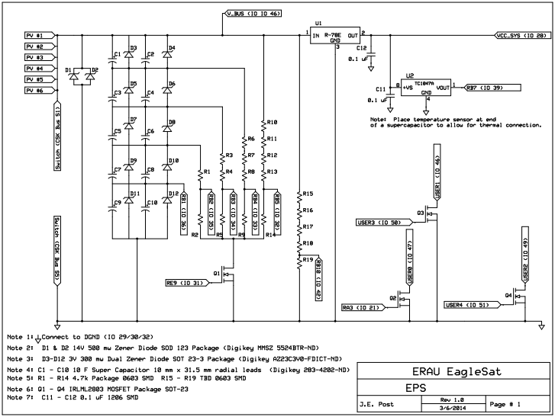
Electronic Power System
Super capacitor energy storage
15V rail to radio
3.3V rail to CPU
Driving factor in solar power design
Schematic credit
to Dr. J. E. Post
Notes:
First time a Cubesat has been attempted with Supercaps instead of batteries (as far as I know)
15V Rail is solar straight to radio
3.3V buck conversion
Provided several constraints and criteria for solar optimization (segway)

Slide 5
Optimization
Energy
Size Voltage Power
10cm x 10cm
5-15V
Maximize
$$E=\frac{1}{2}CV^{2}$$
S |  | P | Cells | Voltage | Power
1 | x | 22 | 22 | 2.19 | 1.35
2 | x | 11 | 22 | 4.38 | 1.35
3 | x | 7 | 21 | 6.57 | 1.29
4 | x | 5 | 20 | 8.76 | 1.23
5 | x | 4 | 20 | 10.95 | 1.23
6 | x | 3 | 18 | 13.14 | 1.10
7 | x | 3 | 21 | 15.33 | 1.29
8 | x | 2 | 16 | 17.52 | 0.98
9 | x | 2 | 18 | 19.71 | 1.10
10 | x | 2 | 20 | 21.9 | 1.23
11 | x | 2 | 22 | 24.09 | 1.35
S |  | P | Cells | Voltage | Power
7 | x | 3 | 21 | 15.33 | 1.29
S |  | P | Cells | Voltage | Power
1 | x | 22 | 22 | 2.19 | 1.35
2 | x | 11 | 22 | 4.38 | 1.35
3 | x | 7 | 21 | 6.57 | 1.29
4 | x | 5 | 20 | 8.76 | 1.23
5 | x | 4 | 20 | 10.95 | 1.23
6 | x | 3 | 18 | 13.14 | 1.10
7 | x | 3 | 21 | 15.33 | 1.29
8 | x | 2 | 16 | 17.52 | 0.98
9 | x | 2 | 18 | 19.71 | 1.10
10 | x | 2 | 20 | 21.9 | 1.23
11 | x | 2 | 22 | 24.09 | 1.35
Structural compatibility
Weight
Cost
Notes:
Size constraints
Tabulation
Voltage constraints
Cap. Energy leads to higher voltage choice for same power
(STRUCTURE WEIGHT AND COST SHOW AGAIN IN DESIGN PROCESS SO DO NOT SPEND MUCH TIME)
Structural – Pumpkin or Inhouse compatible
Weight – Minimize without sacrifice to structural strength
Cost – Always minimized

Slide 6
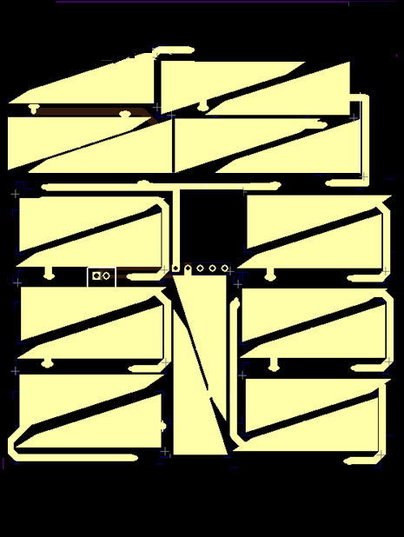
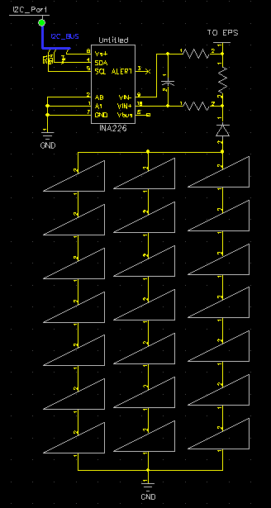
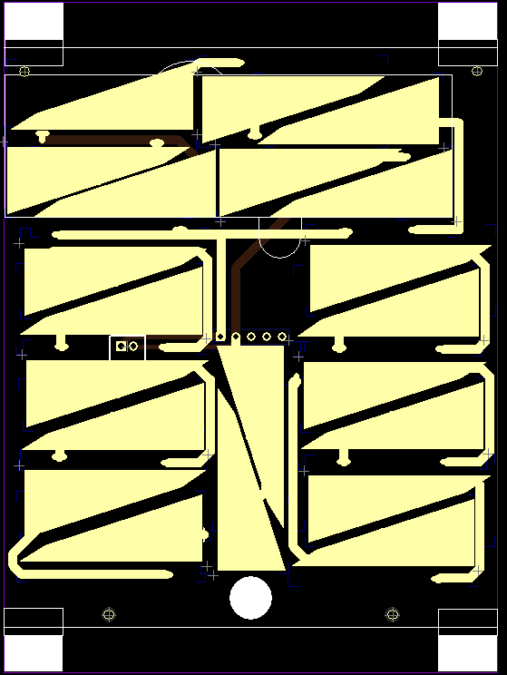
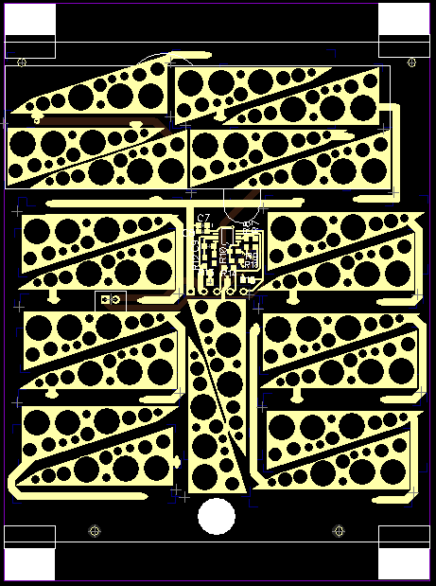
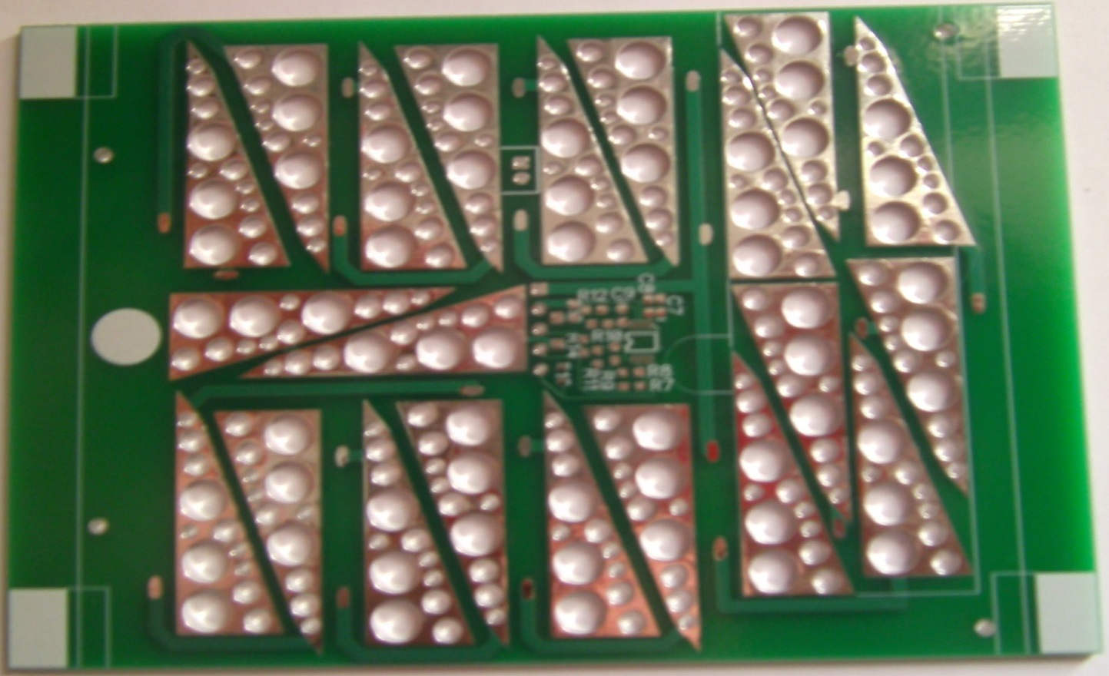
Design
Structural compatibility
Weight
Cost
$135 per side
Notes:
First a schematic was created
Then rough draft of PCB
-Structural
Cut inhouse to fit either structure
-Weight
Holes prevent solder mounds and reduce weight
-Final Product $135/side - $810 for the whole satellite

Slide 7
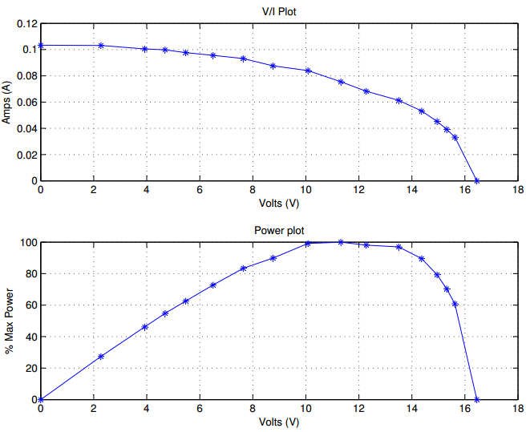
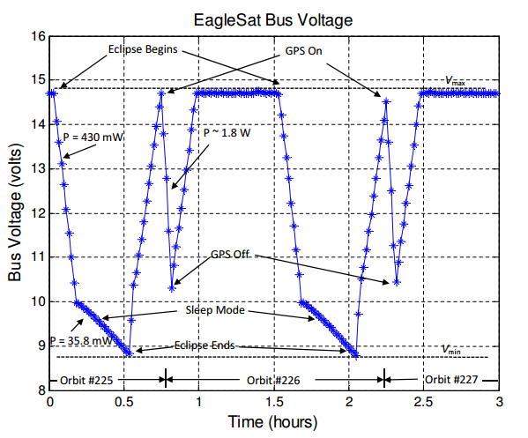
Testing
Past
Current Vs. Voltage
Power
Future
Rotation Vs. Power
Fight test
Course Attitude Determination
Testing and Plots Credit to Dr. J. E. Post
Notes:
Current Vs Voltage characteristics of existing design – Defines Max power operation zone,
% Max – shows how much time is spent in Max power range
EagleSat bus voltage – Shows simulated dynamic model of orbit
Credit Dr. Post for tests and results
Future testing
- Power During tumble (terrestrial and thermal-vac)
- HASP Flight – CalPoly Conformity Testing
- Class Project to simulate Attitude Determination from solar and Accel/Mag sensor

Slide 8
Risks
Risks
Main risk is lack of power
Solution: Active duty cycle control algorithm
SuperCap - Leakage
Solution: Test Results
Solar Cell Degradation
Solution: Research and Testing
Structural rigidity
Solution: Thicker PCBs
Notes:
1-CPU is sleeping when power is low to implement active Duty Cycle
2- Same 5 caps have been tested in an out of vacuum chamber for ~2 months and have shown to change to already minimal leakage
3 Gallium Arsenide is more reliable then Silicon usually used, expected ~2% loss / year (needs Cited)
4 Thicker PCBs for flight design if the Engineer models are not structurally sound

Slide 9
Personal Improvement
Engineering Compromise
New design process lifecycle
System level engineering perspective
Technical Skills
Schematic Design
PCB Design
Surface mount soldering
Time Management

Slide 10
Acknowledgments
Space Grant
Mr. Jack Crabtree
ERAU
Team EagleSat
Dr. John E. Post
Dr. Gary Yale
Dr. Ron Madler
Undergraduate Research Institute – Ignite!
Questions?

